Slide 1
DJIA Stock Analysis
Jeffrey Dean, Yuvik Umapathy, Yiwei Han

Slide 2
Introduction
We focused on the stock market and the index we choose is The Dow Jones Industrial Average. This is also commonly referred to as THE dow Jones, which is one of the most popular and widely-recognized stock market indices. It measures the daily stock market movements of 30 U.S. publicly-traded company listed on the NASDAQ or the New York Stock Exchange (NYSE). The 30 publicly-owned companies are considered leaders in the United States economy.

Slide 3
What’s the idea ?
Investors get nervous and anxious of the future trends of the stock prices in the markets
The primary area of concern is to determine the appropriate time to buy, hold or sell.
However, the stock market is complicated, dynamic and chaotic.
The goal:
Construct tools that can give us an idea of what stocks in the Dow Jones Industrial Average are worth buying or selling

Slide 4
Part 1: Buy/Sell Indicators for DJIA Stocks
The goal of Part 1 of this study was to identify the best points/dates to buy or sell specific stocks in the DJIA
Tried to do this in as few lines of code as possible so this method could be reproduced very easily
Hence the closing prices of the last 100 days of each stock were used
Used the method of rolling averages to try and predict the best times to buy/sell the stock
Not Computationally Costly and produces decent results
Visualizations were made to show these points

Slide 5
First Steps
Started with adapting HW3 by reading the DJIA information from Wikipedia using pandas
https://en.wikipedia.org/wiki/Dow_Jones_Industrial_Average
Pulled the information from each stock from its corresponding finance.yahoo url
https://finance.yahoo.com/quote/“TICKERNAME”/history?p=“TICKERNAME”
Added the Adj Close Price column as an array to the DJIA data frame
Named the column “close”

Slide 6
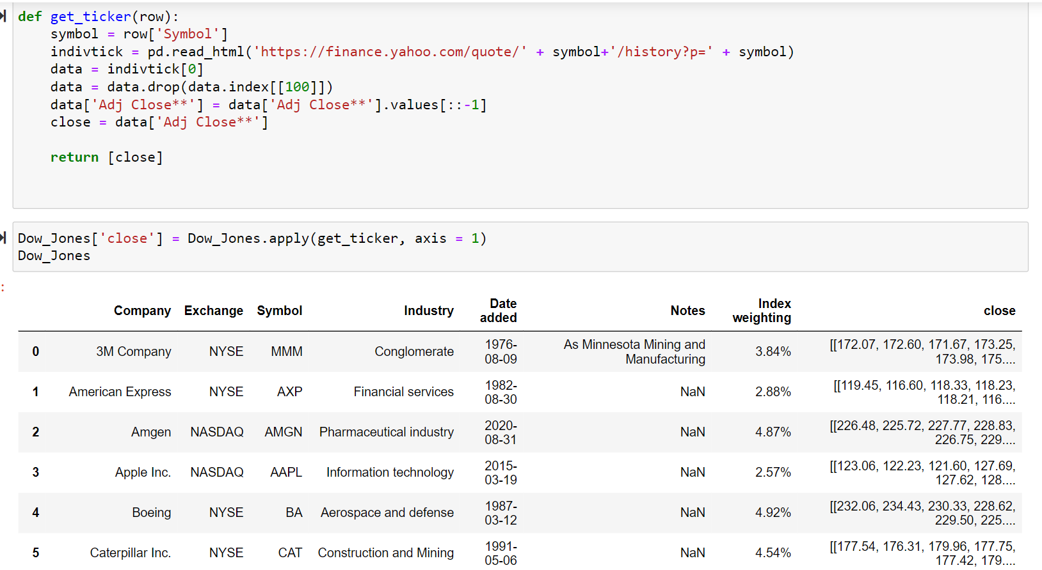
Getting Closing Prices of Last 100 days

Slide 7
Cleaning the Adj Closing Price Column
When taking the Adj Closing Price column directly from yahoo finance, some cleaning needed to be done
The closing price data was taken in reverse chronological order
Since stock prices update daily, order starts from most recent
Dividend splits were also included, entry included words as well
Whole row had to be deleted

Slide 8
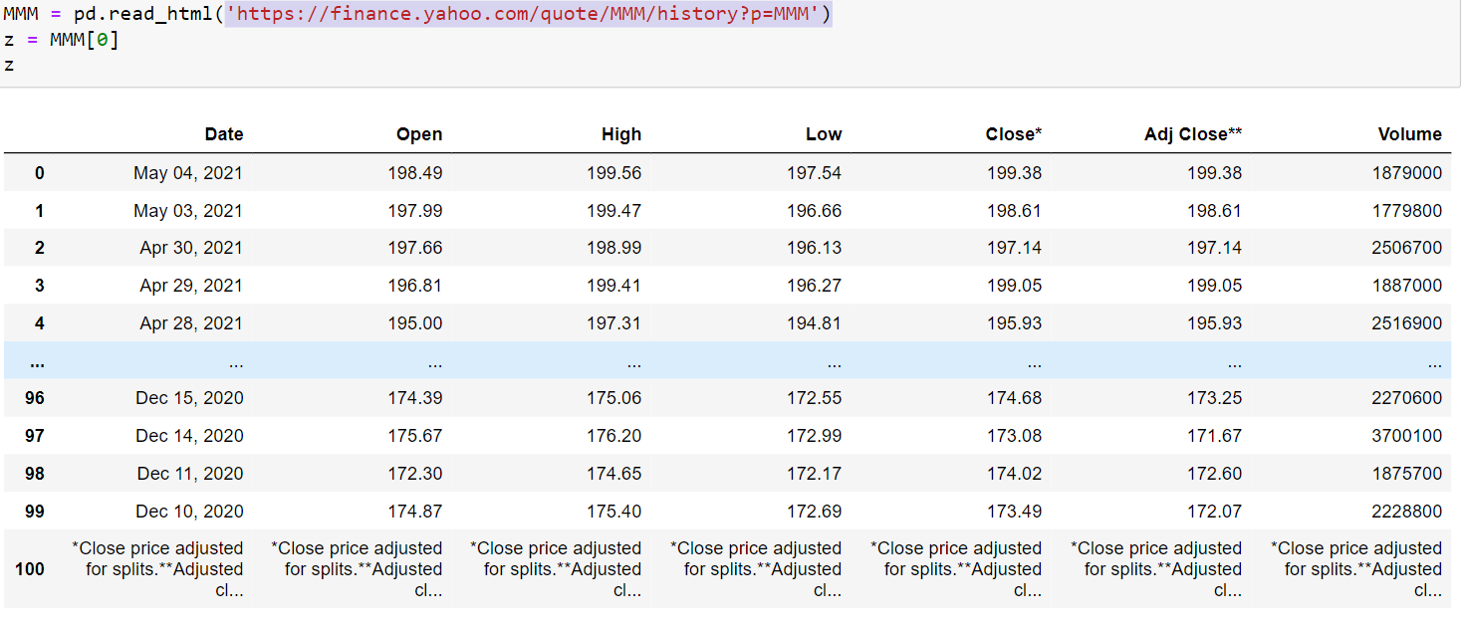

Slide 9
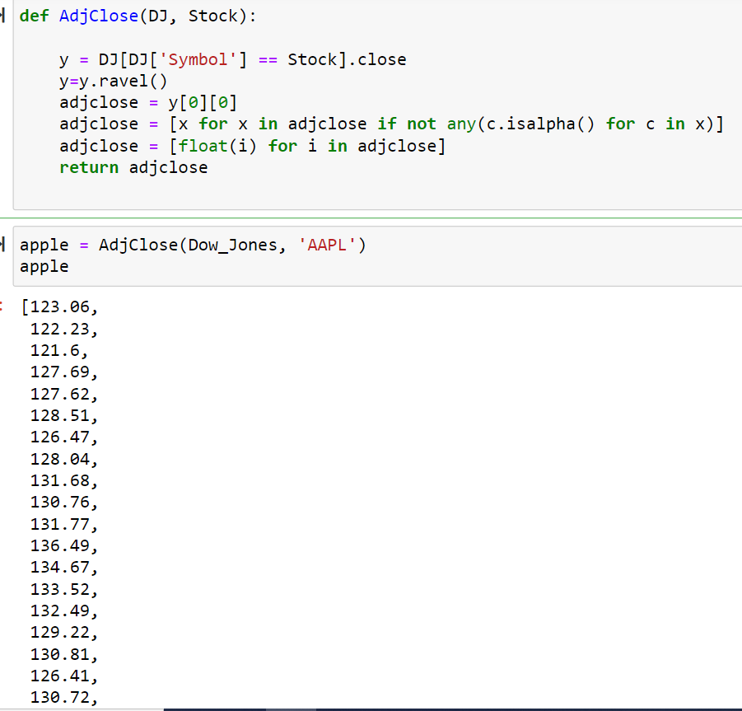

Slide 10
Next Steps
Calculated 5 and 10 day moving averages (1 & 2 weeks) for each stock
Added it to the closing price data frame
Created a function that indicated a buy signal if the 5 day moving average > 10 day moving average and a sell signal if the opposite happened
Also made a function to plot the closing prices of a specific stock, 5 & 10 day rolling averages, and the buy/sell indicators on the same graph

Slide 11
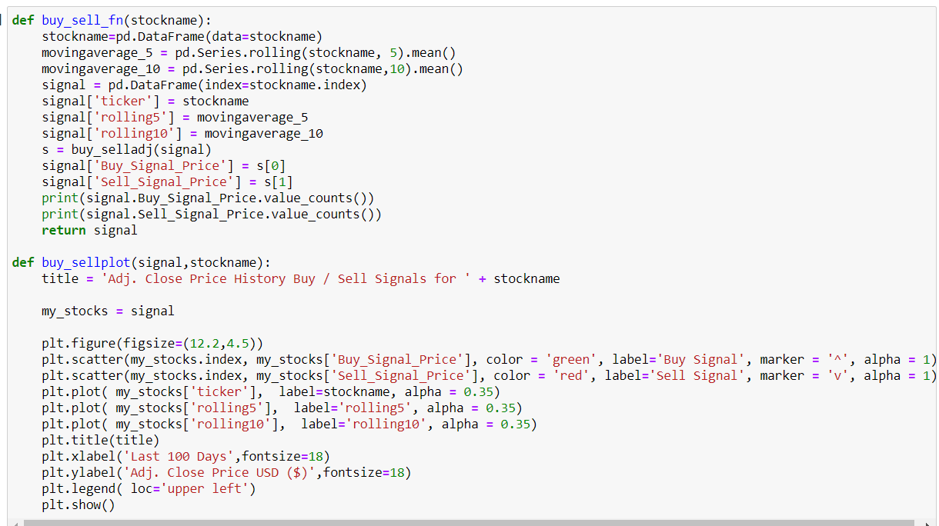

Slide 12
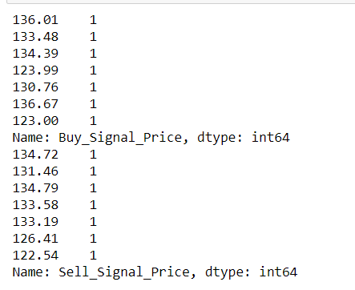
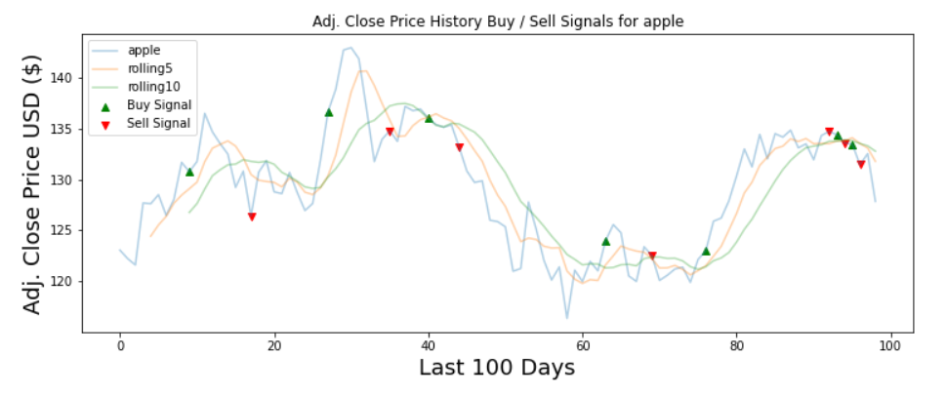
Apple

Slide 13
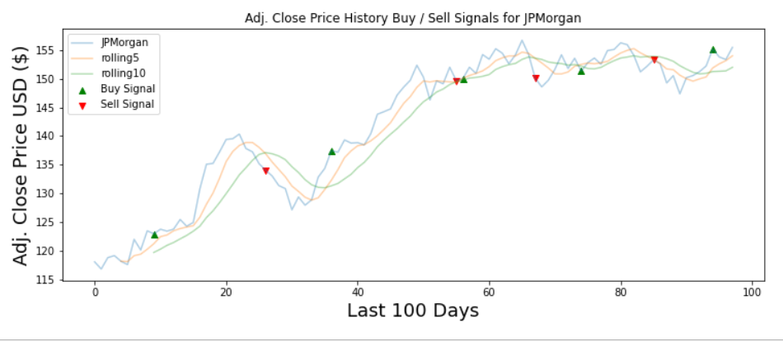
JPMorgan

Slide 14

Microsoft

Slide 15
General Conclusions
For days/weeks of upward or downward movement, this model does extremely well in predicting when to buy or sell
However, since the sample size is 100 days, there are some changes that the model cannot account for (sudden drops in closing price)
But, model knows to sell the stock immediately the next day, which is a very good sign
Since the 10 day rolling average starts after the 5 day one, there will automatically be buy/sell indicator on the 10 day mark
Hard to judge whether its prediction is right or wrong, simple answer: it depends

Slide 16
How to improve this model
Find a way to get more than 100 days worth of data without compromising the speed of the program
Rather than convert every csv of closing prices into a df using pandas, find a smart way to get it from the internet (similar to yahoo finance idea)
Try some machine learning techniques to predict buy/sell indicators
Would attempt to use rolling averages in the model
More research would have to be done because we aren’t predicting the next closing price
Use our model on stocks not in the DJIA and compare/contrast the results
Ex: NASDAQ100

Slide 17
Part 2: Market Performance and the User
Goal of Part 2 is to build a tool that gathers data on Dow Jones 30 companies and then seeks to determine returns and standard deviation of returns for these companies.
The data will be developed into a graphic and then a regression line is added to the points. From there the information will be sent out to an email address supporting relevant information and the graph generated.
Users will want to know data on outliers of the 30 firms and the maximum returns or maximum volatility within the set in question.

Slide 18
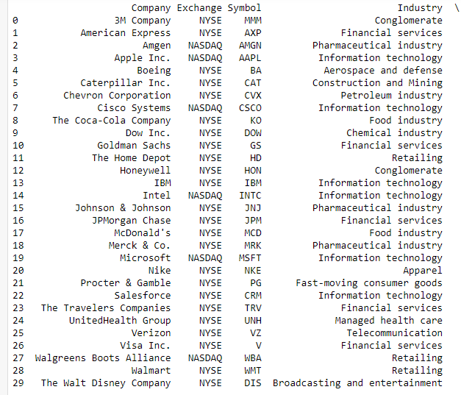
Pulling Stock Information
Data is pulled from Yahoo Finance API

Slide 19
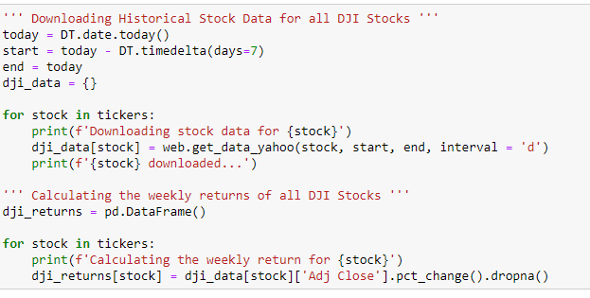
Yahoo Finance Pull Code

Slide 20
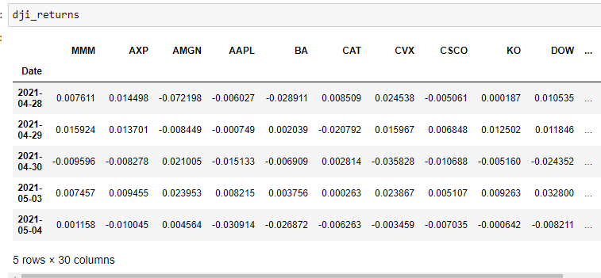
Example of Return Data Pulled - Weekly Data

Slide 21
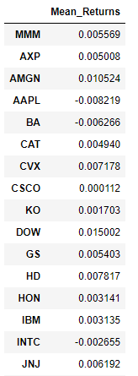
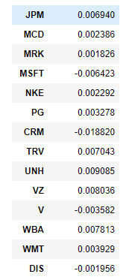
Dow Jones Mean Returns Data

Slide 22
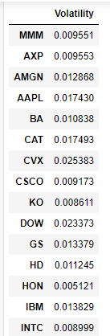
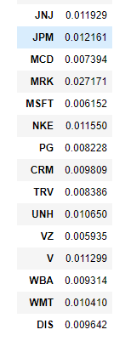
Dow Jones Volatility Data

Slide 23
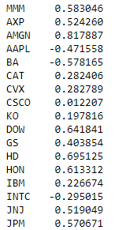
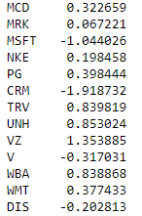
Dow Jones Mean Sharpe Ratio Data

Slide 24
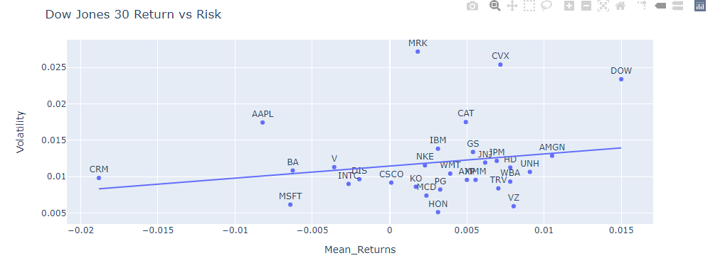
Return vs Risk Graph Dow Jones 30

Slide 25
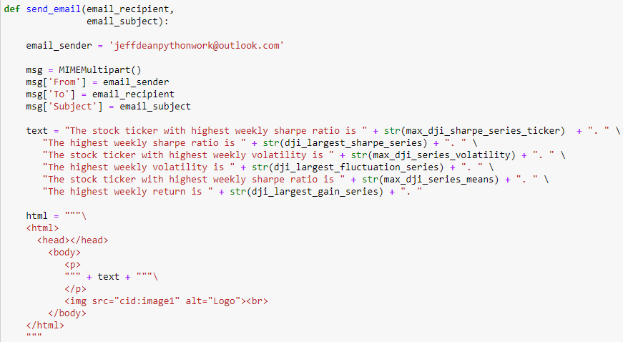
Email Details and Code Part 1

Slide 26
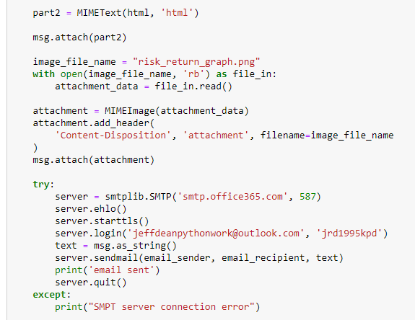
Email Details and Code Part 2

Slide 27
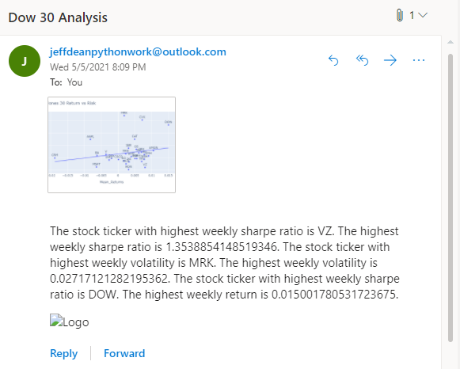
Email Output

Slide 28
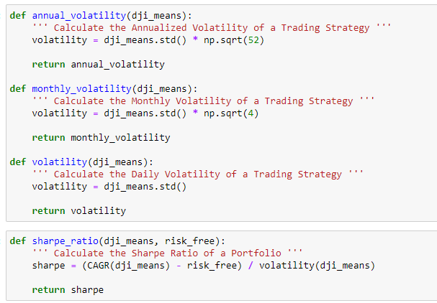
Other Functions Built- Volatility, Sharpe Ratio

Slide 29
Conclusions
We can leverage programs to pull data, clean it, and visualize it to interpret work on financial data.
The recommendation tool can be given parameters and support if an investor should buy or sell a position including timing the investment.
Models can be adapted to support new tools and methods to support sophisticated financial strategies, including with machine learning.
The tools can be leveraged to find return and risk on investment portfolios over a time horizon and automate email functions for an investor.

Slide 30
Thanks!

